Slide 1

COMPUTER SECURITY
SC3010
Group 65 : Aryan, Brandon, Dong Wan, Seo Jin
Notes:
Hello prof, today we will be presenting on our computer security project. We are from group 65 and my name is Brandon

Slide 2
CONTENTS
Ryuk Ransomware
Introduction Attack Lifecycle Methodologies and TTPs
Presented by- Brandon DongWan
ShellShock
Introduction Attack mechanism Vulnerabilities Code analysis Code Demo
Presented by - Seo Jin Aryan
Notes:
Our presentation will cover 2 cyber securiy incidents, namely Ryuk Ransomware and Shell Shock. I will be presenting on Ryuk ransomware with Dong Wan while Shell shock will be presented by seojin and aryan

Slide 3

01
RYUK
RANSOMWARE
Notes:
Lets start the presentation on Ryuk Ransomware

Slide 4
Ryuk Introduction
Fin12
Time to Ransom
Naming convention by Mandiant
2 days compared to mean dwell time of 5 days
Victims
Services Used
71% America, 12% Canada
Bypass Cyber Kill Chain (CKC)
Victim’s Industries
Leverages Tools
83% Private, 17% Public
Utilizes public tools (ie. Beacons, TrickBot, etc.)
Notes:
So let me introduce to you who is Ryuk. Ryuk has been labeled as Fin12 by Mandiant and are potentially russians attackers.
Their main targets are american companies amounting to 71% of their attacks and canada with 12%. The victim’s revenue ranges from at least 300 million USD.
Targeted industry sectors include mainly healthcare, education, government agencies, high-value businesses and manufacturing. As ryuk is not a Ransomware as a service (RaaS) they do not avoid attacking healthcare organizations as they believe that they will pay the ransom.
Ryuk is well known for their speed of attack as they only require 2 days to deploy their ransomware whereas other type have a dwell time of 5 days.
Ryuk also make use of services to bypass cyber kill chain. This is proven by monitoring their bitcoin transaction where 30% of bitcoin transaction after ransom is transferred out.
Ryuk leverages public tools such as Beacons and TrickBot.
Industries -
Leverage tools - can talk about how 30% of bitcoin payments go to them
SOurce : Bitcoin Transactions
Mandiant analyzed a limited set of Bitcoin wallet transactions that were associated with payments made by FIN12 victims. We assess with high confidence that victim payments are split among various threat actors, which is consistent with our belief that FIN12 leverages initial access providers, and likely other partners, to complete all aspects of the attack lifecycle. In several of the transactions, a portion of the victim funds were cashed out at cryptocurrency exchange services, including Huobi and Binance.
• In multiple cases, we saw evidence of victim payments being divided among seemingly disparate Bitcoin wallets. For example, in one case, 30–35% of the victim payment was subsequently sent to a wallet associated with a suspected initial access provider.
• The subdivision of profits after payment is consistent with ransomware operations more broadly, where access providers, partners with specific skillsets (e.g., penetration testers), and/ or ransomware operat

Slide 5
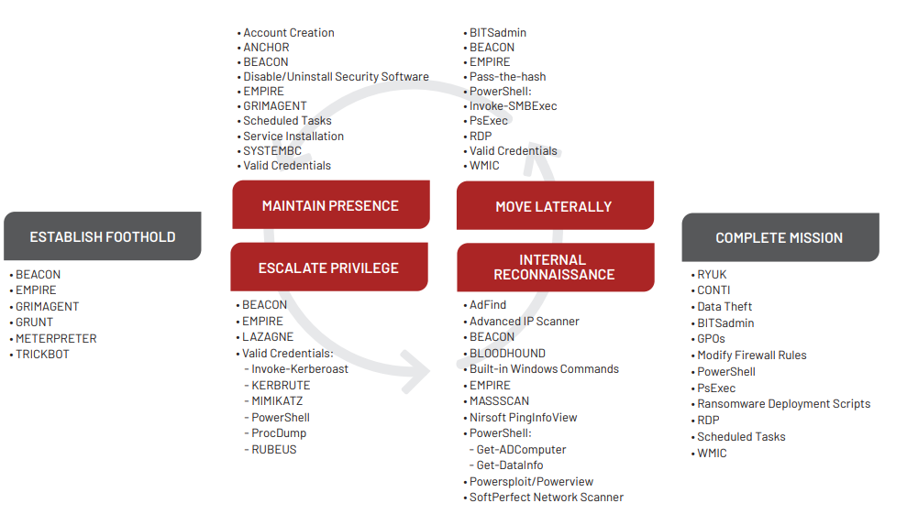
Attack Life Cycle
Notes:
https://www.mandiant.com/sites/default/files/2021-10/fin12-group-profile.pdf
Show attack cycle instead of timeline as they are ransomware. Alot happening concurrently
In this slide we want to show Ryuk attack life cycle as it is not really possible to show a timeline. As they are a ransomware group, they would have many attacks ongoing concurrently.
In this presentation we want to focus on how Ryuk maintains its presence, Escalate privilege , do internal recon and move laterally as we believe is the main part of ryuk attack as we believe that they usually purchase initial access to their victim’s network. I will not pass the time to Dong Wan to further elaborate on the 4 points using Beacon and Powershell.

Slide 6
Attack Techniques & Tools
 | Internal Reconnaissance | Lateral Movement | Persistence | Privilege Escalation
Beacon | Command execution via Windows Command Prompt (cmd.exe) | Powershell, Windows Management Instrumentation (WMI) | Malleable Command & Control (C2) server | Elevate Kit
Notes:
Elevate Kit allows operators to integrate their privilege escalation exploits as Cobalt Strike commands. This kit was released in December 2016. Unlike other kits, this is public, and it is essentially just an Aggressor Script to streamline loading your own PowerShell scripts, binaries, etc. into a BEACON session (see “Aggressor Scripts”).
Library that allows ryuk to integrate privilege escalation exploits
PowerShell:
Internal Recon
Lateral Movement
Persistence:
NewBCtestnDll64 module spawns a PS script that downloads Empire PowerShell.
Empire PowerShell establishes and maintains a reverse shell, which acts as a backdoor, with the infected victim machine.
Privilege Escalation

Slide 7
Vulnerabilities Exploited
CVE-2018-8453
High-severity (7.8/10)
Privilege Escalation tool
Target devices:
Windows 7 to 10 machines
Windows Server 2008 to 2016
Any Kernel with Read / Write permissions can be run
CVE-2019-1069
High-severity (7.8/10)
Privilege Escalation tool
Target devices:
Windows 10 machines
Windows Server 2016 and 2019
Hard link attack using Task Scheduler Service
Notes:
The vulnerabilities we are focusing on are privilege escalation tools as we believe that gaining the highest privilege is the most important and detrimental to a company as being a Superuser / Administrator means being able to do anything on the system.
The first vulnerability would be CVE2018-8453 …….

Slide 8



Attack Mechanism
Phishing emails
Behaves as a Trojan Horse
Perform internal reconnaissance
Establish persistence:
Malleable Command & Control (C2) server (Beacon)
Modification of Windows Registry Run keys (MITRE ATT&CK T1547.001)
Task scheduler (MITRE ATT&CK T1053.005)
Lateral movement
Encrypt files
Demand ransom

Slide 9
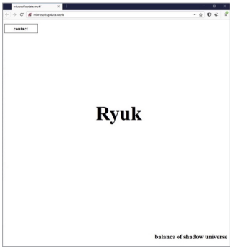
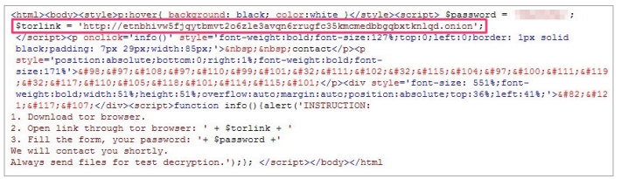
Ransomware Defacement

Slide 10
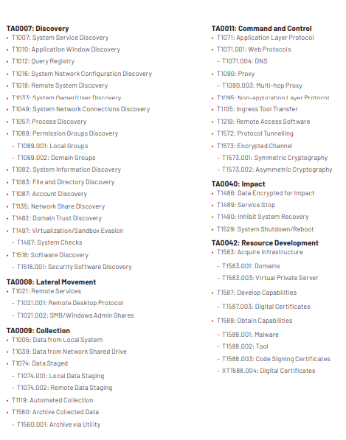
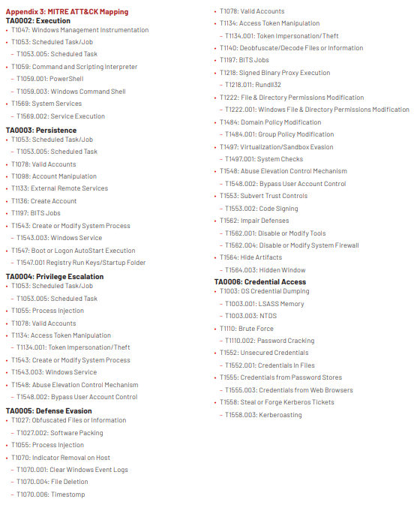
Mitre attack technique codes
Notes:
https://www.mandiant.com/sites/default/files/2021-10/fin12-group-profile.pdf

Slide 11
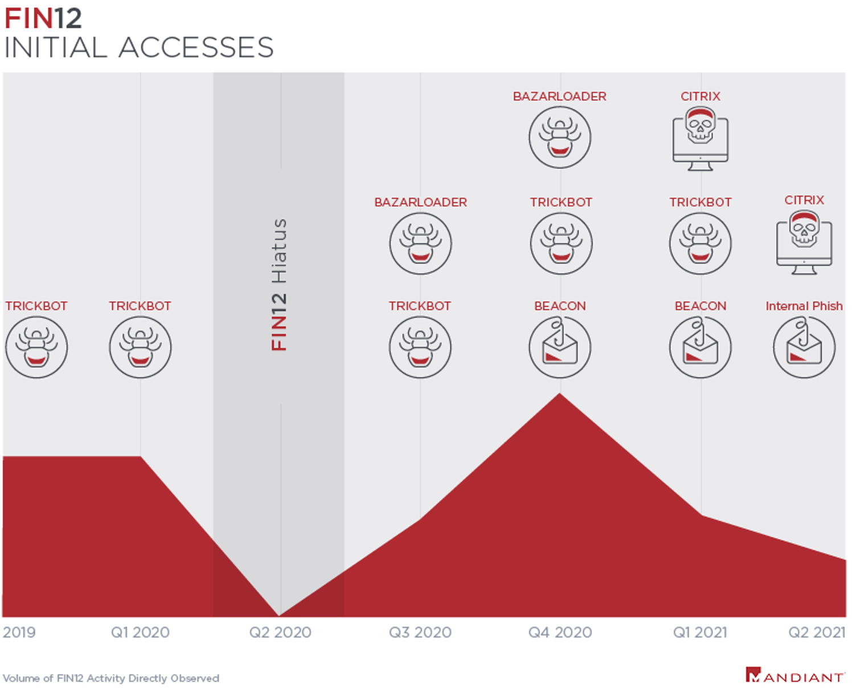
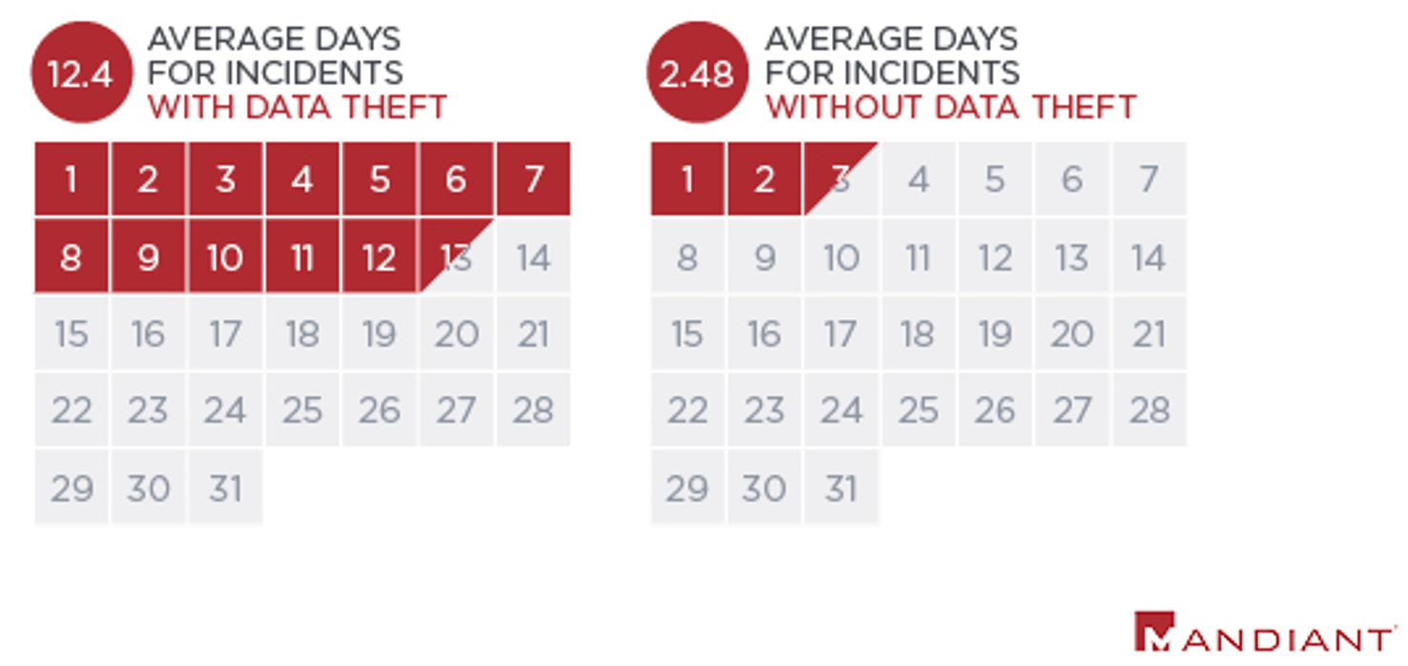
https://www.mandiant.com/resources/blog/fin12-ransomware-intrusion-actor-pursuing-healthcare-targets
Dwell time is 2.5 days compared to 5 days which is global mean. So they are very very fast in attacking

Slide 12
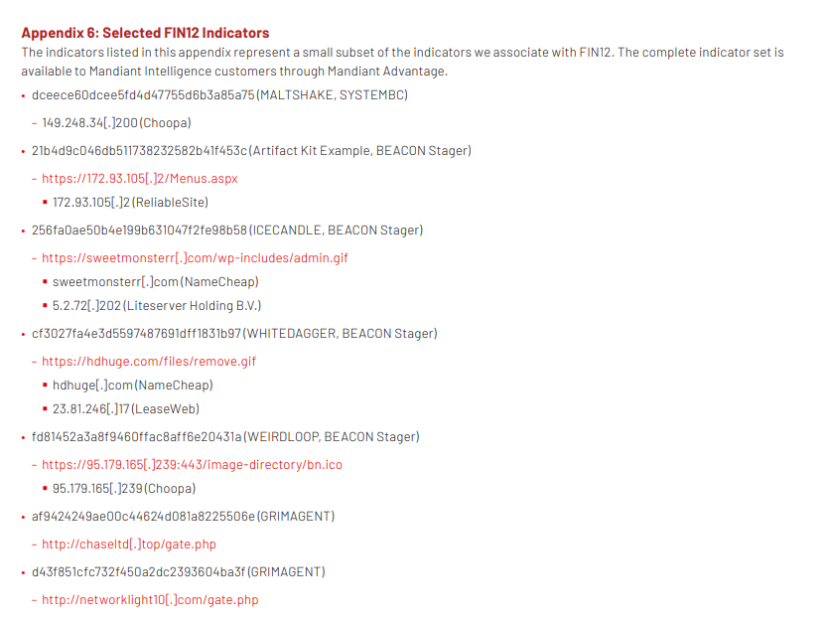
Diamond model

Slide 13

02
SHELLSHOCK
Notes:
Now we will start the presentation on ShellShock

Slide 14
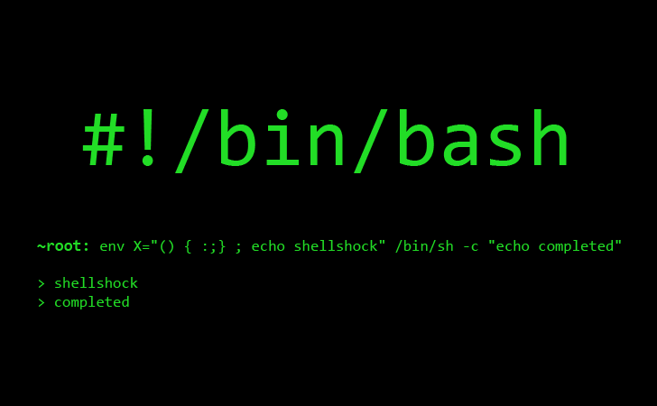


Attack Mechanism
Critical Bug found in GNU Borne - Again Shell (BASH)
Significant Impact with widespread use of Unix-based systems
Gain unauthorised control over systems
Notes:
In September 2014, a critical bug, known as Shellshock (CVE-2014-6271), was found in the BASH shell. This vulnerability, rooted in the mishandling of environmental variables, allowed attackers to inject malicious code, leading to unauthorized command execution and potential system compromise. The widespread impact on Unix-based systems and network devices prompted urgent mitigations and fixes to prevent further exploitation. Shellshock's motive was to gain unauthorized control, posing risks of unauthorized access, data theft, and system compromise.
https://www.pwc.com/sg/en/risk-assurance/assets/shellshock-vulnerability.pdf

Slide 15
Vulnerabilities Exploited
CVE 2014-6271 (Original Shellshock)
High severity (10/10)
Injection vulnerabilities
Malicious payload stored in environment variable
Affect BASH version 1.14 up through 4.3
CVE 2014-7149
CVE 2014-7186
CVE 2014-7187
Notes:
The initial Shellshock vulnerability, identified as CVE-2014-6271, originated from how Bash imported functions stored in environment variables. The loophole of allowing appending of additional code to the end of the function definition allowed attackers to execute arbitrary code whenever the Bash shell was initiated by storing malicious payload in an environment variable.

Slide 16
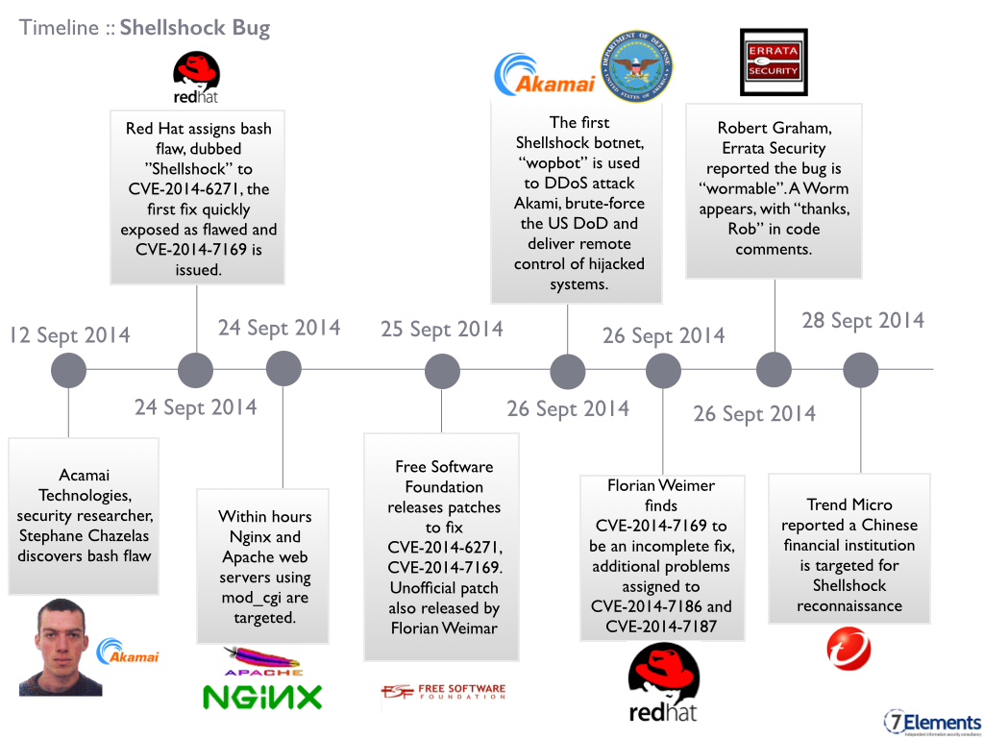
ShellShock Timeline
Notes:
https://www.cvedetails.com/cve/CVE-2014-6271/
Now we will be looking into key events of ShellShock’s Timeline.
On 12 September 2014, bash flaw was discovered.
On 24 September, the bash flaw was identified as Original Shellshock, and its first patch was soon known to be flawed and Shellshock 2.0 was issued.
On the same day, Nginx and Apache web servers that utilised mod-cgi was targeted.
A day after, patch to fix Original Shellshock and Shellshock 2.0 was released, but it was found to be incomplete and additional problems were assigned on 26 September.
While bash is not completely fixed, there are two major ongoing developments that aims to mitigate the problem.One to add prefix to prevent functions from having same names as system variables and allowing import of environmental variables by bash only when it is explicitly requested.
Now I will be handing over to Aryan for code analysis and code demo.
1 min 40 sec total.

Slide 17
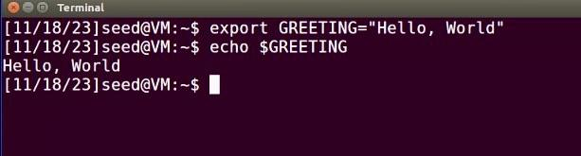
Code Analysis
Environment Variables
Usage:
Programs pass arguments to Bash via environment variables
Potential Risk: Environment variables can leak sensitive information or create vulnerabilities

Slide 18
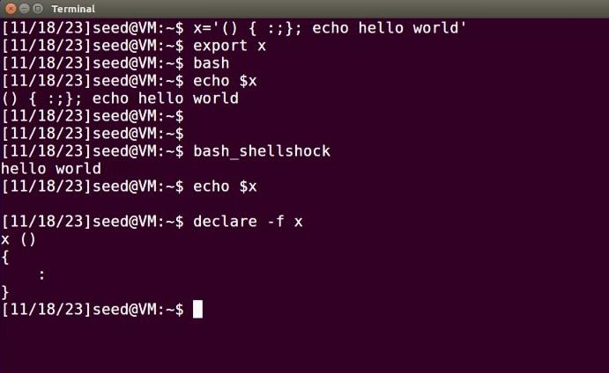
Code Analysis
Bash Behaviour:
Automatically imports functions from environment variables
Exploit:
Appending malicious code to function definitions
Impact:
Allows arbitrary code execution when a Bash shell is initiated

Slide 19

Code Demo

Slide 20
Thank You!
Notes:
This is the end of our presentation. / This concludes our presentation. Thank you

